Slide 1
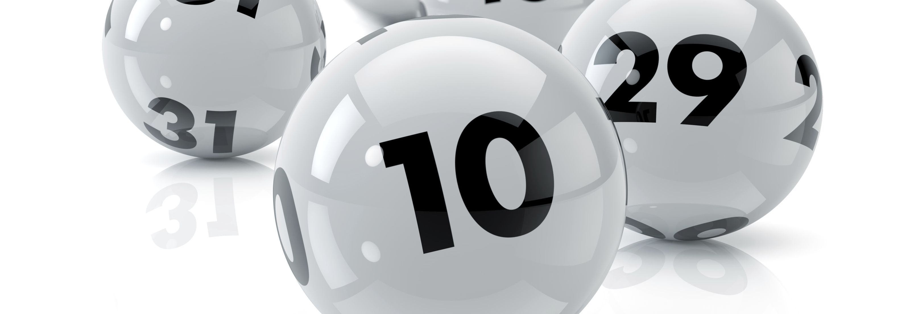
Charity Lotteries in the United Kingdom
Sarah Fetherston-Dilke
7th December 2018

Slide 2
Charity lotteries - a sector in flux?
Momentum behind (overdue?) deregulation
Striking a balance before the next National Lottery franchise is awarded
Political decision making beset by macro events and Ministerial changes

Slide 3
The lotteries ecosystem
The National Lottery
Founded by the 1993 National Lottery Act
Funding is distributed by 12 lottery bodies
Society Lotteries
Governed by the Gambling Act 2005
Categorised as large or small according to thresholds
491 non-commercial societies hold 847 large licences (2016/17)
Not to scale

Slide 4
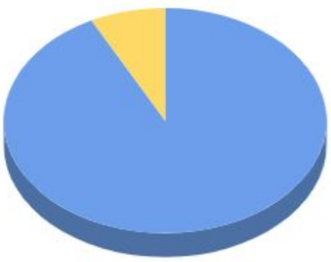
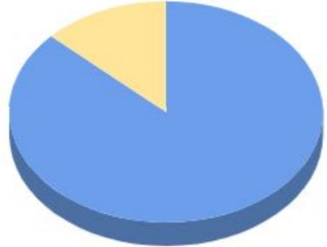
The lotteries ecosystem
Total Sales (2016/17)
Total Contribution to Good Causes (2016/17)
National Lottery
Large Society Lotteries
National Lottery
Large Society Lotteries
Source: https://assets.publishing.service.gov.uk/government/uploads/system/uploads/attachment_data/file/720930/society_lotteries_consultation_june_2018_pdf.pdf

Slide 5
The lotteries ecosystem
Contributions to good causes from The National Lottery (Apr 2017 – Mar 2018) (1.5% increase from Apr 2016 – Mar 2017)
Contributions to good causes from large society lotteries (Apr 2017 – Mar 2018) (15.7% increase from Apr 2016 – Mar 2017)
Source: https://www.gamblingcommission.gov.uk/Docs/Gambling-industry-statistics.xlsx

Slide 6
The political dynamic: society lotteries since the Gambling Act 2005
Society lotteries
Innovation
Problem gambling
Umbrella lotteries
Generational trends
Health of the National Lottery
Sector coherent view
Political focus elsewhere
A genuinely difficult decision

Slide 7
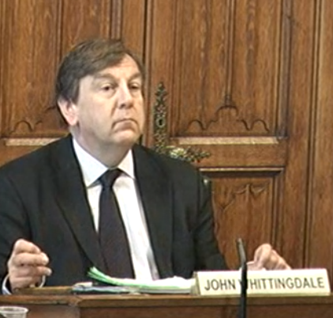
Parliamentary scrutiny
Committee recommendations – July 2014
Greater differentiation between large and small lotteries
Established (or large) should provide more to good causes.
Reintroduce the 35% cap on operating costs for largest lotteries.
A new class of umbrella lottery
Gambling Commission should review market
Notes:
“The Committee wishes to examine the role of society lotteries and their place within a system which includes the Health Lottery and the National Lottery.”
Culture Media and Sport Select Committee inquiry (July 2014)
Greater differentiation between small (largely local) lotteries and large lotteries “especially those run by commercial organisations”
New lotteries should continue to be required only to share 20% of the ticket receipts to good causes (rather than allocated to prizes or operating expenses) but established (or large) should provide more than this minimum.
The 35% cap on operating costs other than prizes and money set aside for roll-overs should be reintroduced for the largest lotteries.
A new class of umbrella lottery should be introduced with its own set of limits on individual draws, annual sales and prizes. Limits to overall amounts raised / paid, numbers of linked lotteries, etc.
The Gambling Commission should the review market and make recommendations to the Government.

Slide 8
A decade on from the Gambling Act 2005, DCMS launch wide ranging call for evidence on Lotteries
“The Government is committed to ensuring that all lotteries are able to maintain and grow their share of the market for good causes while upholding player protection. We are also committed to maintaining the health of the National Lottery.”

Slide 9
Whilst society lotteries lobby for deregulation

Slide 10
A complementary ecosystem
Source: https://www.gamblingcommission.gov.uk/Docs/Gambling-industry-statistics.xlsx

Slide 11
A complementary ecosystem
“society lotteries are now a fundamental part of the giving landscape alongside The National Lottery” (Tracey Crouch, Minister for Sport and Civil Society)¹
“Our aim… is to achieve a balance between enabling the sustainable growth of society lotteries…while also protecting the unique position of the UK-wide National Lottery.” ²
“the growth of the society lottery sector has not been at the detriment of National Lottery sales.”³
^{1 / 2} DCMS consultation on society lottery reform, June 2018
³ Gambling Commission advice to DCMS, 2018
Notes:
All the while…. complementary lotteries provide complementary and much needed funding for good causes

Slide 12
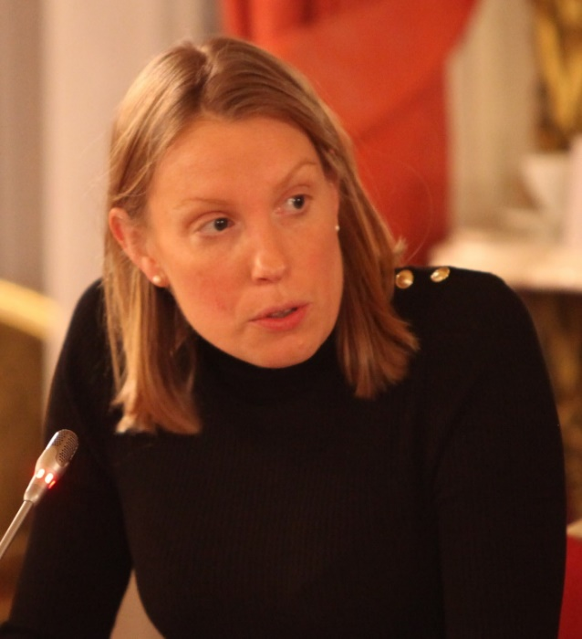
Where are we now? A deregulation package for society lotteries
Large society lotteries
Individual per draw sales limits:
Raising the limit to £5 million
Individual per draw prize limits:
Raising the limit to £500,000 (Government’s preferred option)​
Annual sales limits:
Raising the limit to £100 million (Government’s preferred option)​
Small society lotteries
Individual per draw sales limits:
Raising the limit from £20,000 to £30,000 or £40,000
Annual sales limits:
Raising the sales limit from £250,000 to £400,000 or £500,000

Slide 13
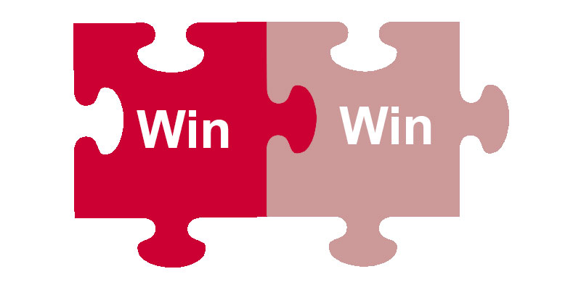
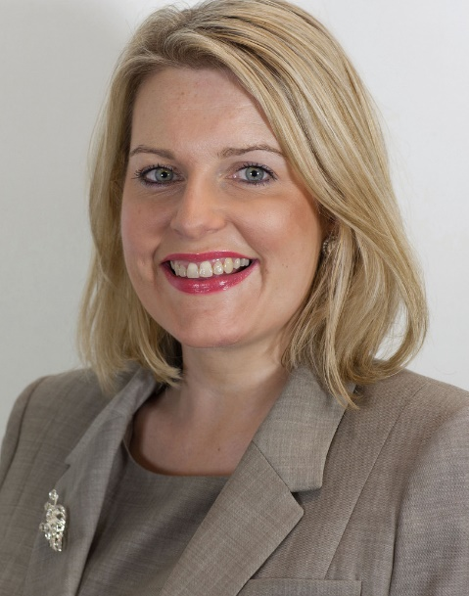
Striking a balance ahead of the next National Lottery franchise…
…with a new ministerial team

Slide 14
Sarah Fetherston-Dilke
sarah.fd@instinctif.com

